Slide 1


Get Set Goal

Slide 2
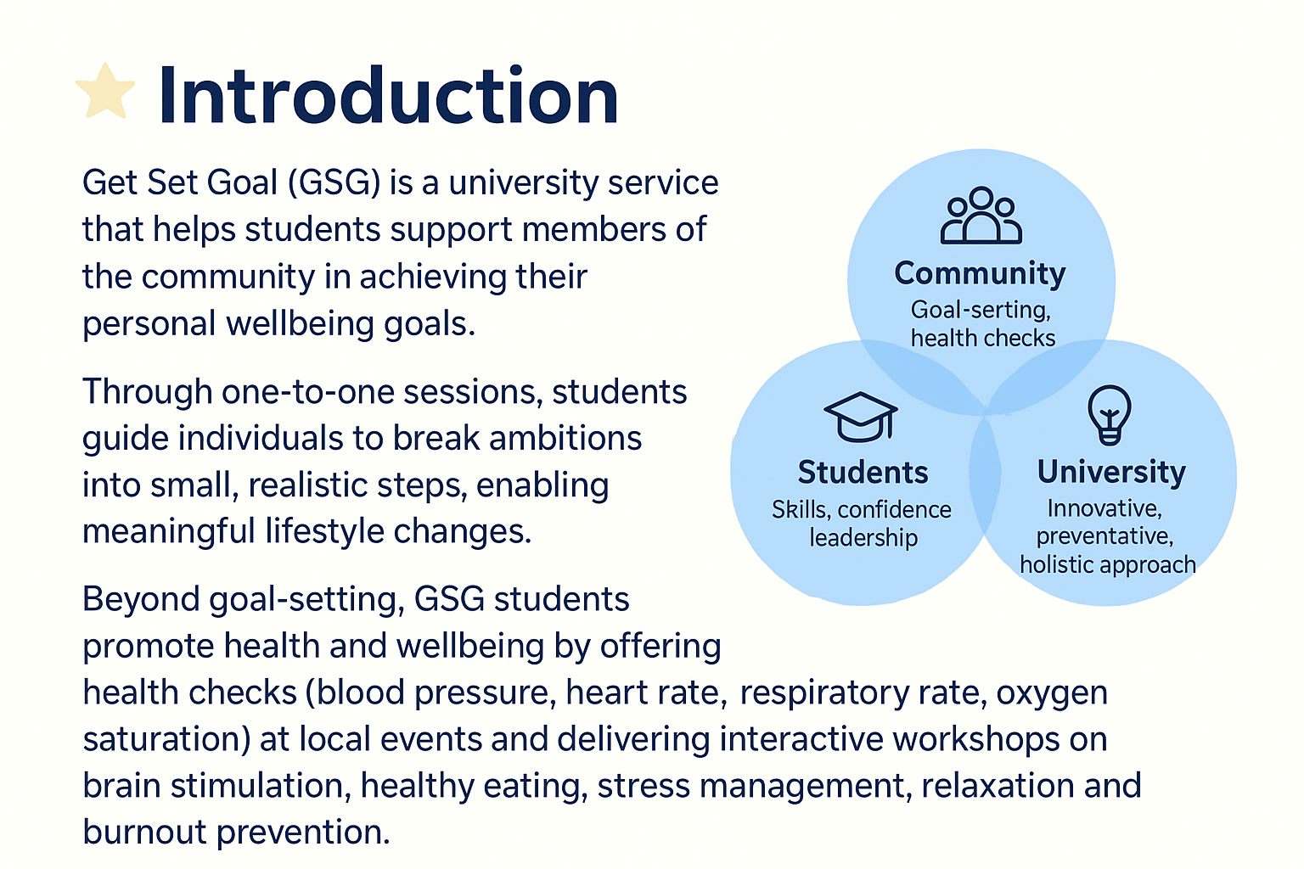

Slide 3
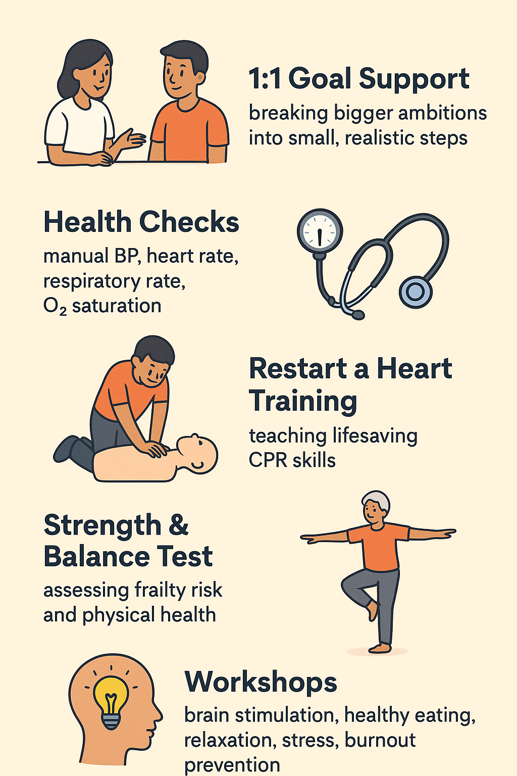
What does Get Set Goal offer

Slide 4
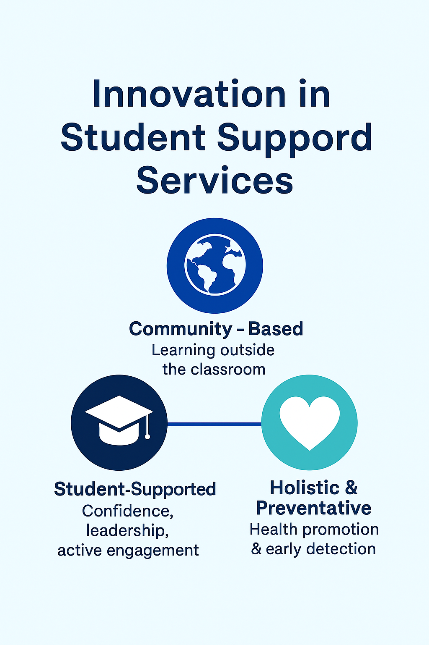
•A Different Learning Environment
Students are given opportunities to practice skills outside hospital settings, working directly in the community with diverse groups of people.
•Student Supported Services & Empowerment
GSG gives students the chance to take the lead in health checks, workshops and one-to-one sessions – not just observing but actively engaging and educating.
•Holistic & Preventative Care
The service focuses on early detection, health promotion and lifestyle changes that can prevent serious conditions, such as cardiovascular disease from developing.
•Bridging the Gap
By linking theory to practice, GSG supports students in building confidence, applying knowledge and seeing firsthand the positive impact of healthcare in real-life settings.
Supported

Slide 5
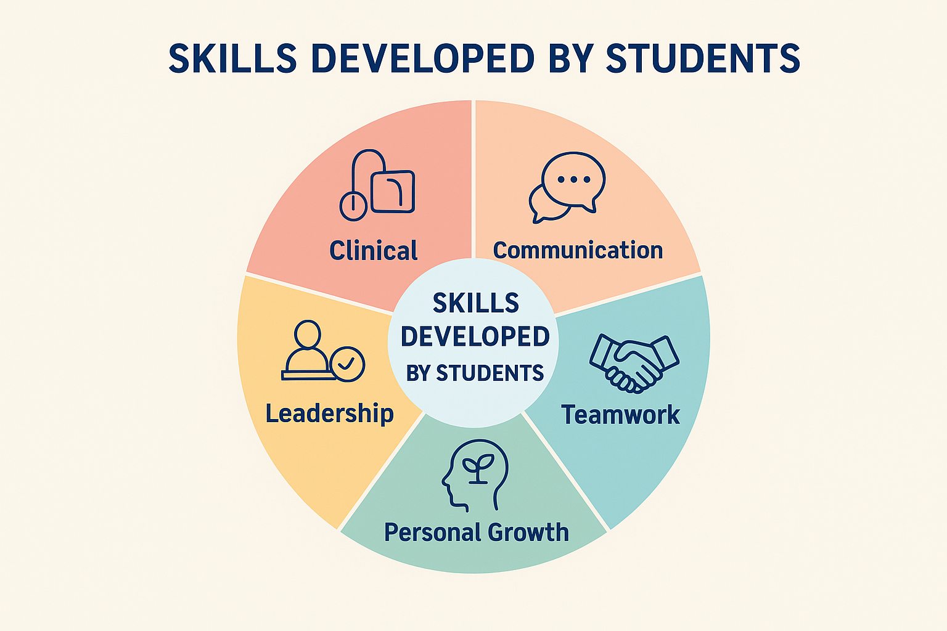
Skills developed by students
Through Get Set Goal (GSG), students develop a wide range
of skills that prepare them for future professional practice:
Clinical Skills
  Manual blood pressure, heart rate, respiratory rate, oxygen saturation
  Applying knowledge in real-world community settings
Communication Skills
  Active listening and motivational interviewing
  Clear and supportive communication with members of the public
Leadership & Confidence
  Leading workshops and public presentations
  Building self-assurance in professional environments
Teamwork & Collaboration
  Working effectively with peers, staff, and community members
  Sharing ideas and responsibilities
Personal & Professional Growth
  Developing empathy, resilience, and adaptability
  Strengthening problem-solving and critical thinking

Slide 6
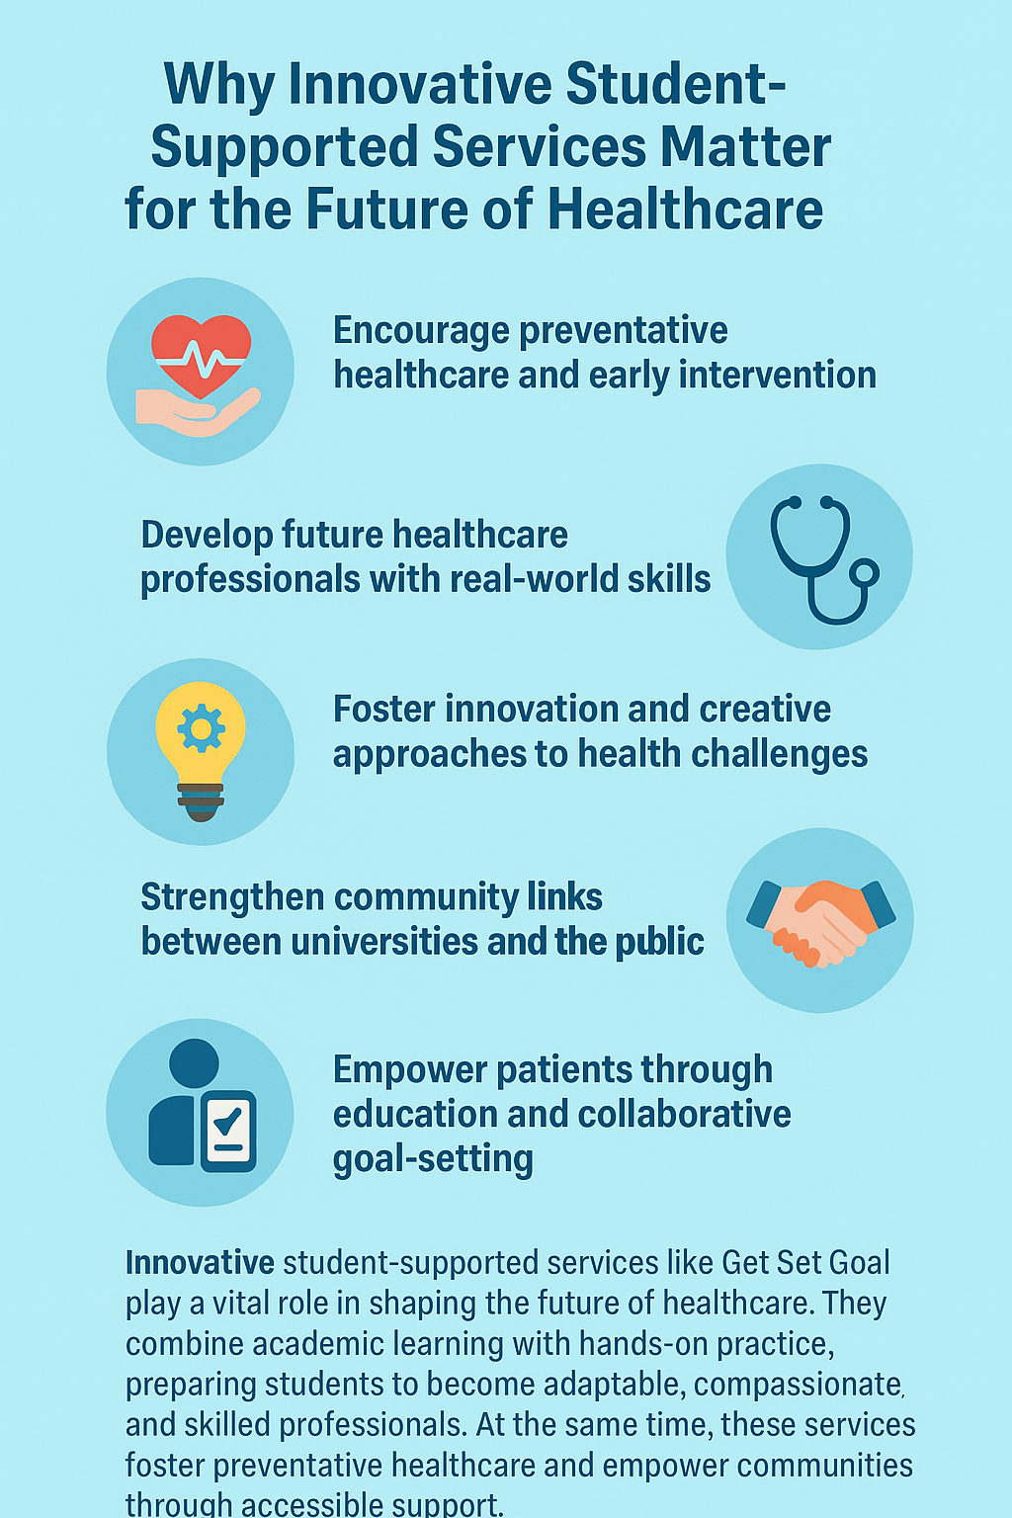
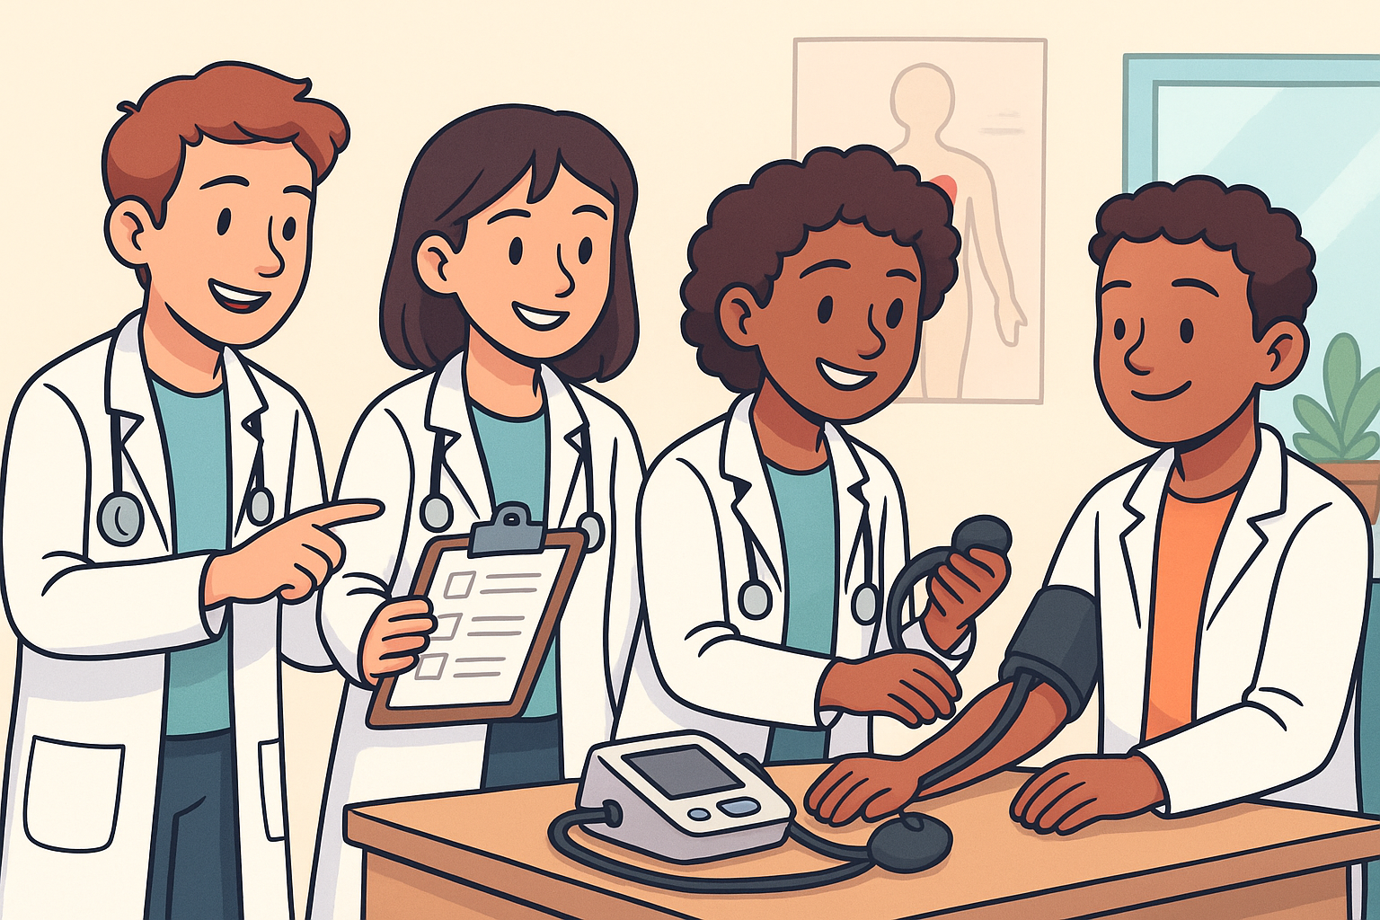

Slide 7
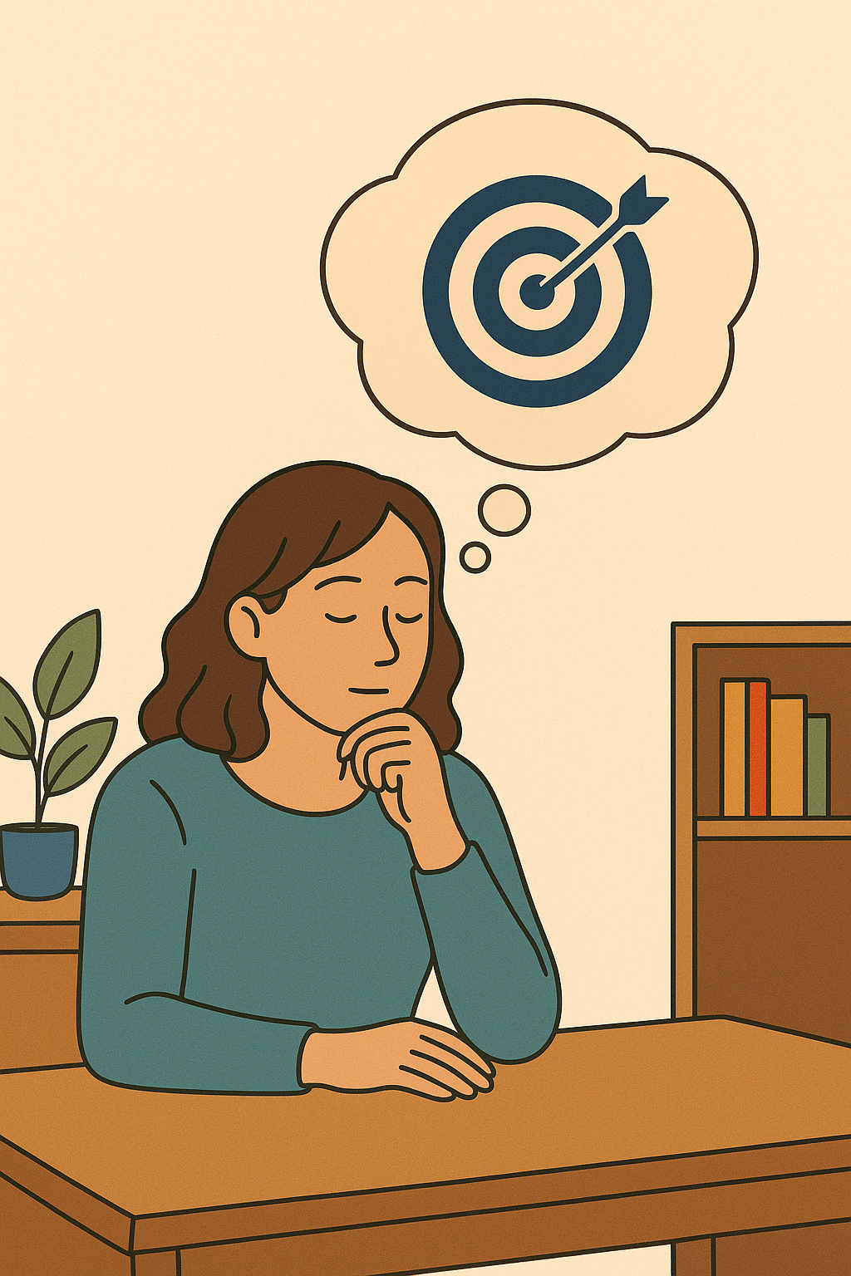
✨ Reflection on Get Set Goal
Reflecting on Get Set Goal (GSG) highlights how valuable this service is for both students and the wider community. For students, it offers the chance to step outside the classroom and put theoretical knowledge into practice in real-world scenarios. Carrying out health checks, running workshops, and supporting individuals with their personal goals all help to build confidence and professional identity.
The service also encourages students to think about holistic approaches to health, where emotional wellbeing, lifestyle factors, and realistic goal setting are as important as clinical care. For many, this reflection demonstrates the value of preventative healthcare and early intervention, as small changes made with community members can have a long-lasting impact on their overall health and wellbeing.
Through this journey, students often recognise their own personal growth, resilience, and adaptability, which are crucial qualities for future healthcare professionals.

Slide 8
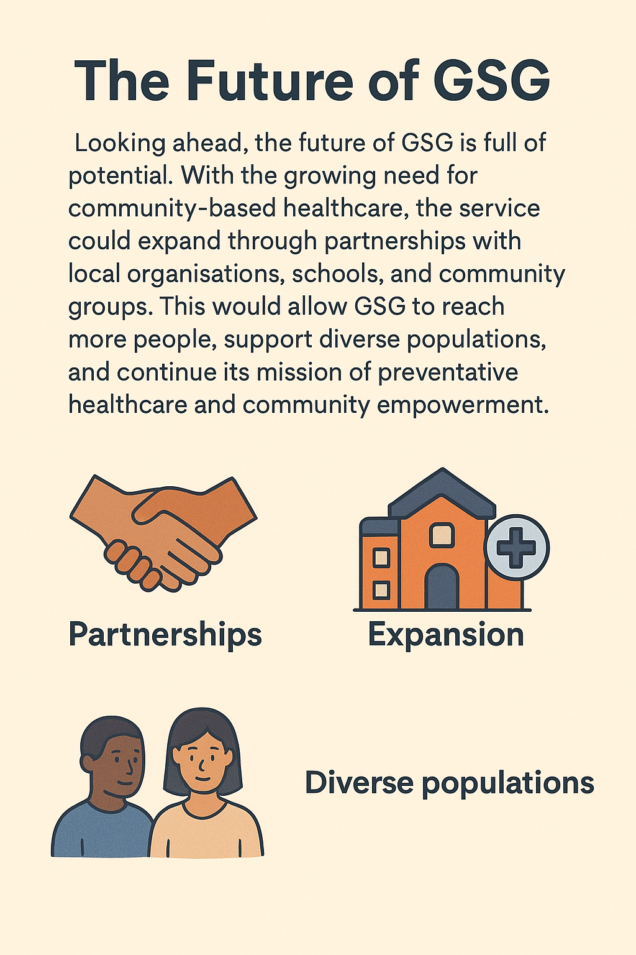
The Future of Community Healthcare
Looking ahead, with the growing need for community-based health care the service is expanding through partnerships with local organisations, schools and community groups. This allows Get Set Goal to reach more people, support more diverse populations and continue its mission of preventative healthcare and community empowerment.

